Slide 1
No (available) data, no paper
Better to start with the end in mind
Adapted by Bruna Piereck
from: Flora D’Anna, PhD [Data steward at ELIXIR Belgium]
Julho/2023 Recife-Brasil

Slide 2
What is Research Data Management (RDM)?
O que é Gestão de dados de pesquisa?
Let’s write a definition
use pens and papers

Slide 3
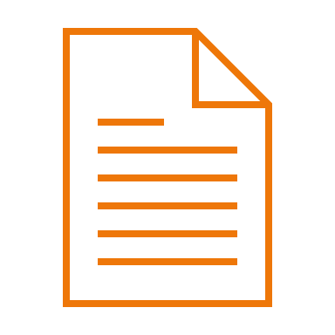


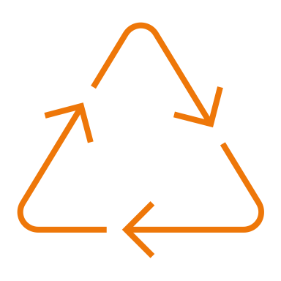
Research Data Management (RDM)
Gestão de dados de pesquisa
All actions necessary to ensure that research data is
Well described
Easy to find
(for humans and machines)
Secure
Reusable
Notes:
What’s research data management?

Slide 4
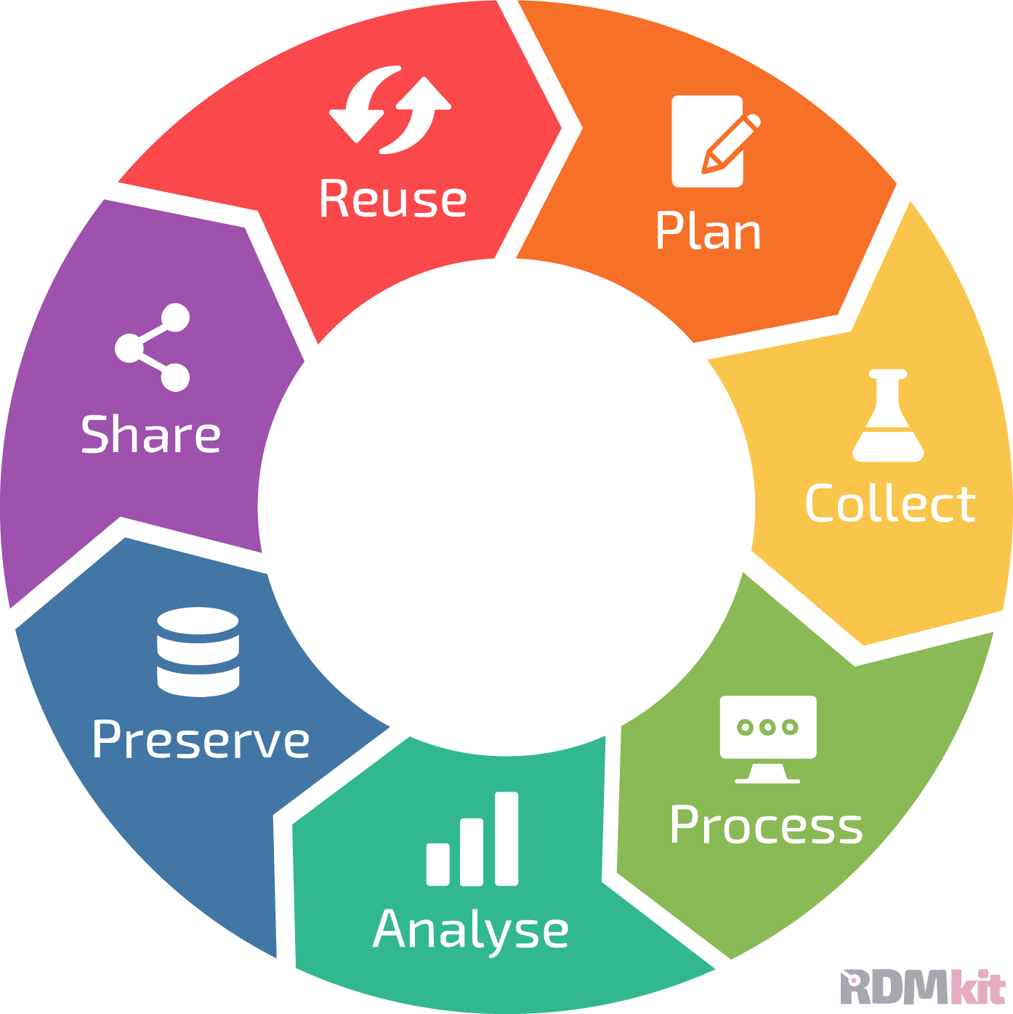
Research Data Management (RDM)
Gestão de dados de pesquisa
All actions necessary to ensure that research data is
Data life cycle: RDM stages
Well described
Easy to find
(for humans and machines)
Secure
Reusable
data life cycle: https://rdmkit.elixir-europe.org
Notes:
Usually, all tasks needed in RDM are organised and explained according to as so called “Data life cycle”, which represents the main steps in RDM: plan, collect, process, analys, preserve, share, reuse. Cycle represets the flow research data goes through.
Source:
- https://rdmkit.elixir-europe.org

Slide 5
Why do we do RDM?
Porquê fazer Gestão de dados de pesquisa?
Let’s write possible reasons
use pens and papers

Slide 6
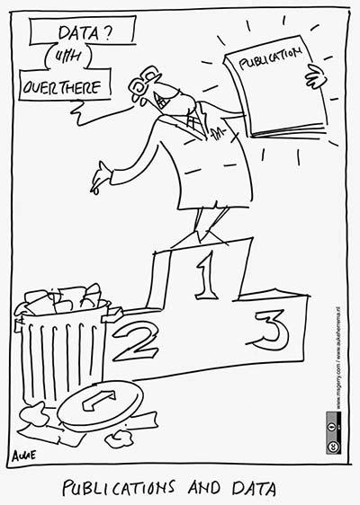
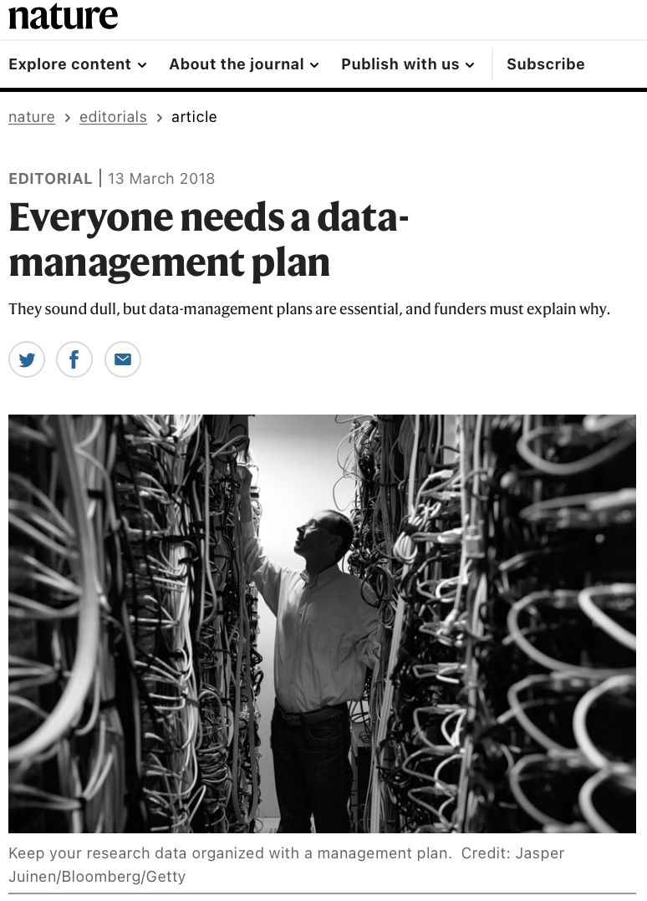
Before
After (now)
RDA Plenary Cartoons by Auke Herrema in CC-BY
doi: https://doi.org/10.1038/d41586-018-03065-z
Notes:
We also care because funders and journals are now asking researchers to focus not only on paper publication, but also on the data itself. In fact, they requires DMP and accessible datasets.

Slide 7
What is data?

Slide 8

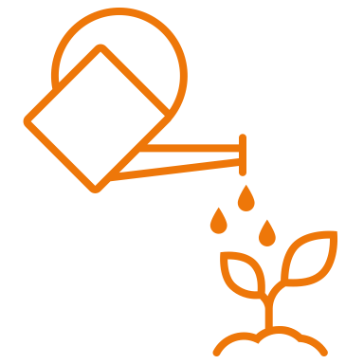

What is data?
Digital or digitalised information
Physical materials
Software, other research output

Slide 9
What is data?
Data life cycle: RDM stages
Digital or digitalised information
Physical materials
Software, other research output
data life cycle: https://rdmkit.elixir-europe.org

Slide 10
What is FAIR and OPEN?
O que significa dizer que os dados são FAIR ou OPEN?
Let’s write possible reasons
use pens and papers

Slide 11
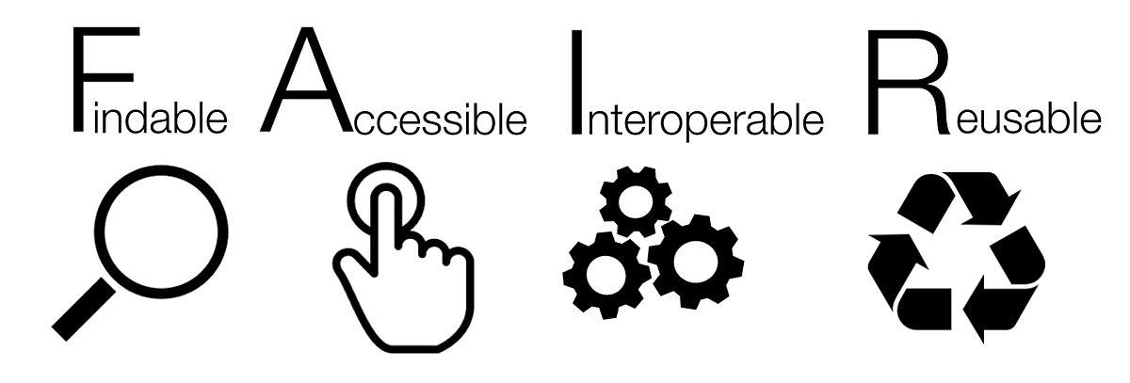
FAIR principles for data and metadata
https://www.go-fair.org/fair-principles/
Sangya Pundir, CC BY-SA 4.0
Notes:
FAIR acronyms applies to data and metadata.
What’s metadata?

Slide 12
FAIR principles for data and metadata
https://www.go-fair.org/fair-principles/
Sangya Pundir, CC BY-SA 4.0
Metadata
keywords
identifiers
machine-actionable (SEO, etc)
Access procedure
e.g., DAC
authentication, identification
…
Standards
Ontologies
Documentation
Licence
Notes:
FAIR acronyms applies to data and metadata.
What’s metadata?

Slide 13
Findable
Your (meta)data can be discovered by others
By whom?
Collaborators, colleagues
Reviewers
Other scientists, society at large
Registries, web crawler
When?
During the project
After the end of the project
How?
Machine-actionbable*
metadata (SEO, etc)
Machine-actionbable keywords
Unique and persistent identifiers
Where?
Searchable resources such as
search engines
databases or repositories
systems for shared storage, etc
registries of metadata
*Machine-actionbable: following standards for machines
Notes:
Sources:
https://www.ugent.be/en/research/datamanagement/after-research/fair-data.htm#WhatisFAIRandwhyisitimportant?
https://rdmkit.elixir-europe.org/machine_actionability
Example:
- Finding a book in a store that doesn’t keep track of the books nor of where the books are VS Finding a book in a store that has a searchable database to keep track of the books and of where the books are.

Slide 14
Findable
Your (meta)data can be discovered by others
By whom?
Collaborators, colleagues
Reviewers
Other scientists, society at large
Registries, web crawler
When?
During the project
After the end of the project
How?
Machine-actionbable*
metadata (SEO, etc)
Machine-actionbable keywords
Unique and persistent identifiers
Where?
Searchable resources such as
search engines
databases or repositories
systems for shared storage, etc
registries of metadata
*Machine-actionbable: following standards for machines
Notes:
Sources:
https://www.ugent.be/en/research/datamanagement/after-research/fair-data.htm#WhatisFAIRandwhyisitimportant?
https://rdmkit.elixir-europe.org/machine_actionability
Example:
- Finding a book in a store that doesn’t keep track of the books nor of where the books are VS Finding a book in a store that has a searchable database to keep track of the books and of where the books are.

Slide 15
Accessible
Your (meta)data can be available to others
To whom?
People and/or machines
Only with the right access permission or authorization
When?
During the project
After the end of the project
How?
Open, free, universally implementable standard protocol to retrieve the (meta)data (e.g. via a “link”)
It could include authentication and/or authorization protocol
Data Access Committee (DAC), etc
Where?
Databases or repositories
Systems for shared storage, etc
Registries for metadata
Notes:
Sources:
- https://www.ugent.be/en/research/datamanagement/after-research/fair-data.htm#WhatisFAIRandwhyisitimportant?

Slide 16
Accessible
Your (meta)data can be available to others
To whom?
People and/or machines
Only with the right access permission or authorization
When?
During the project
After the end of the project
How?
Open, free, universally implementable standard protocol to retrieve the (meta)data (e.g. via a “link”)
It could include authentication and/or authorization protocol
Data Access Committee (DAC), etc
Where?
Databases or repositories
Systems for shared storage, etc
Registries for metadata
Notes:
Sources:
- https://www.ugent.be/en/research/datamanagement/after-research/fair-data.htm#WhatisFAIRandwhyisitimportant?

Slide 17
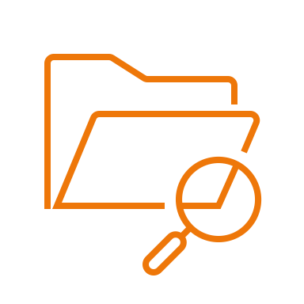
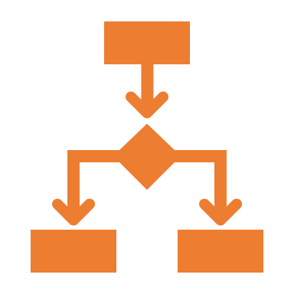

Interoperable
Humans and machines can exchange, interpret and integrate each other’s (meta)data
Non-proprietary file formats that are data exchange formats, for structured data (e.g. JSON, XML, CSV, TSV, FASTQ, FASTA etc.).
(Meta)Data schema defining the relations, such as hierarchy, of the elements that constitute the (meta)data model or structure.
Controlled vocabularies or ontologies to convey unambiguous meaning or semantics (e.g. EFO, OBI, Gene Ontology).
Notes:
Examples:
FASTQ format is open format accepted as standard for sequensing files
Your biological source HAS organism (ontology for species); your DNA library HAS a type = single-end/paried-end (controlled vocabulary)
Genes are annotated with Gene Ontology, that is considered standard by community of biologists
Sources:
-

Slide 18
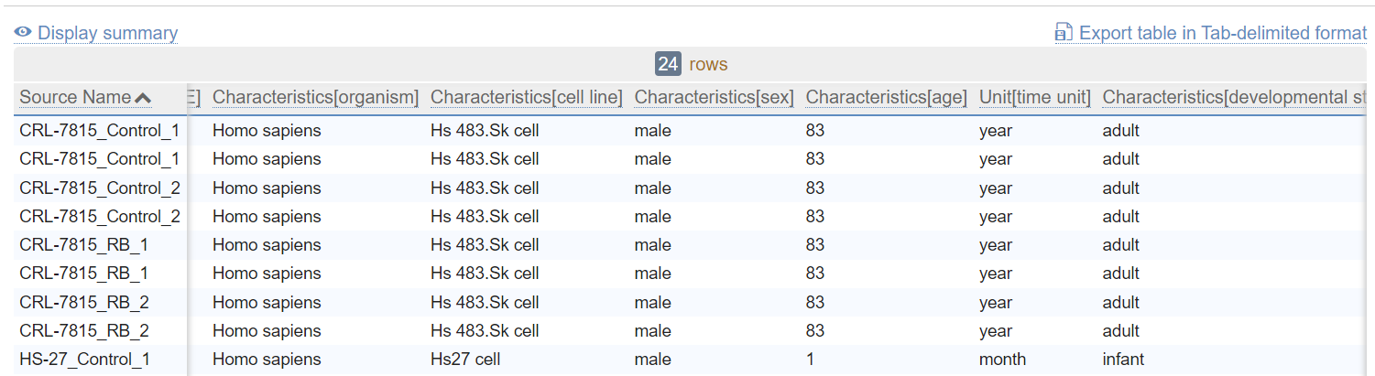
Interoperable: file formats for exchange of structured data
https://www.ebi.ac.uk/arrayexpress/experiments/E-MTAB-11728/samples/
CSV, TSV
Most machines (computers, software) read and open CSV or TSV by “arrenging” the information in columns and rows
Easy to readable for humans as well
Notes:
Most machines (computers, software) ”read” and open CSV or TSV by “arrenging” the information in columns and rows.
Easy to read for humans as well.
In tabular format, the relation between columns are often not explicit for machines. For instance, is “age” refered to cell line, organism or source name?
Also the meaning of each colum header or of each value in the cells is not explicitely explained.

Slide 19
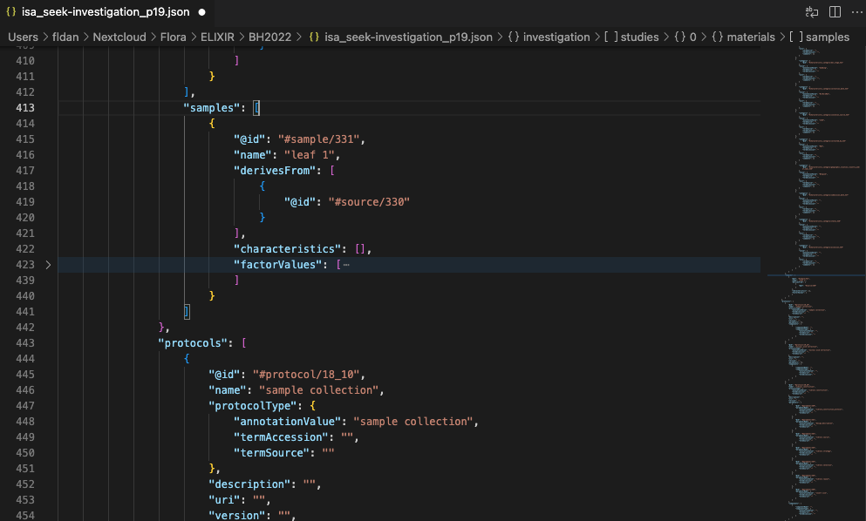
Interoperable: hierarchically structured metadata model
ISA-JSON
Most machines (computers, software) read and open JSON
key : value
Not easy to read for humans
Johnson D, et al. ISA API: An open platform for interoperable life science experimental metadata. Gigascience. 2021 Sep 16;10(9):giab060. doi: 10.1093/gigascience/giab060.
Notes:
Most machines (computers, software) read and open JSON by assigning key:value pairs to corresponding object. For instance, Samples has id, name, and derivesFrom keys.

Slide 20
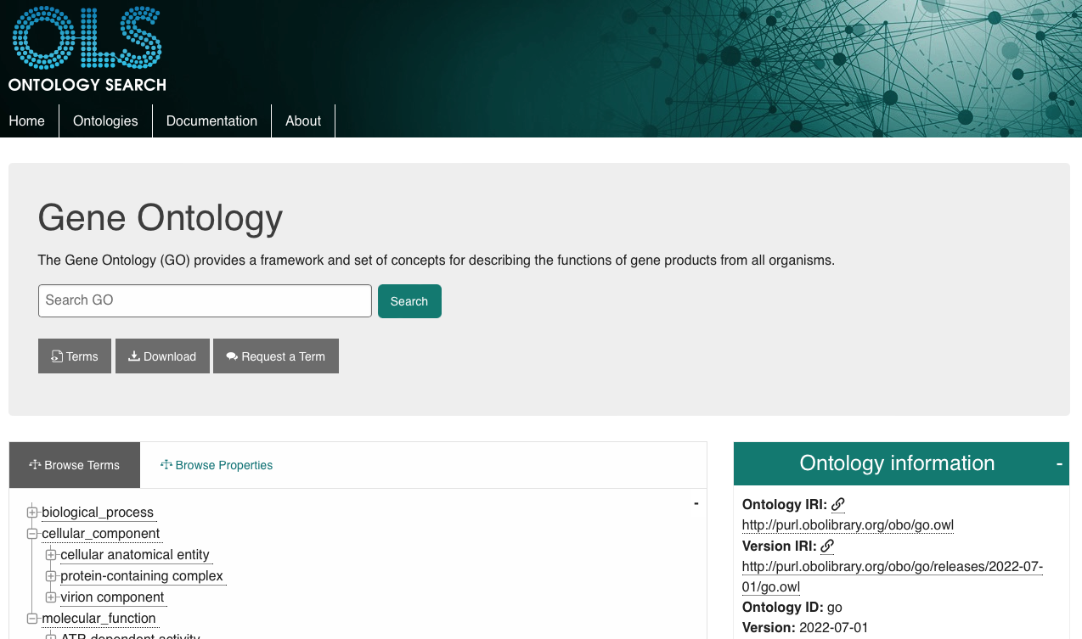

Interoperability: controlled vocabularies or ontologies to convey unambiguous meaning or semantics
Ontology term:
definition
identifier
NCBI Taxonomy for mouse:
Taxonomy ID: 10090
More info at:
https://rdmkit.elixir-europe.org/metadata_management#how-do-you-find-appropriate-vocabularies-or-ontologies
https://faircookbook.elixir-europe.org/content/recipes/interoperability/introduction-terminologies-ontologies.html

Slide 21


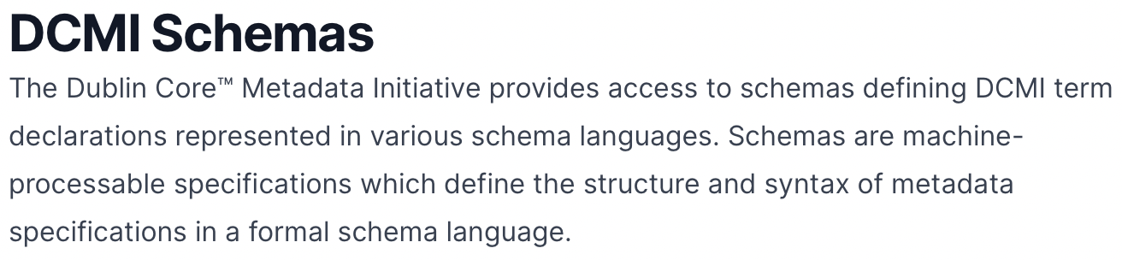
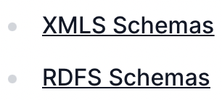
Interoperability: standards and standardization for humans and machines
Use of existing international or domain-specific standards
ISO STANDARDS for dates:
20220715 or 2022-07-15
Notes:
Examples

Slide 22

Reusable
Your (meta)data can be reused by others
Data usage licence
Documentation and metadata (e.g., data provenance, etc)
Challenges
Where to find data to reuse
Permission to reuse for specific purpose
Data quality
How to handle versioning
How to cite
…

Slide 23

Documentation and metadata
Documentation is (unstructured) information about the data.
README.txt
Metadata is highly structured documentation.
Metadata.json

Slide 24
FAIR principles for data and metadata
https://www.go-fair.org/fair-principles/
Sangya Pundir, CC BY-SA 4.0
Notes:
FAIR acronyms applies to data and metadata.
What’s metadata?

Slide 25


OPEN SCIENCE
Freepik.com
“Open means anyone can freely access, use, modify, and share for any purpose (subject, at most, to requirements that preserve provenance and openness).
From Open Definition
“
as open as possible and
as close as necessary.
”
- Author unknown-
as a whole or partially
Rawpixel.com-Freepik.com
FAIR_&_OPEN_training by Bruna Piereck and Patrícia Palagi (X-meeting 2023)

Slide 26
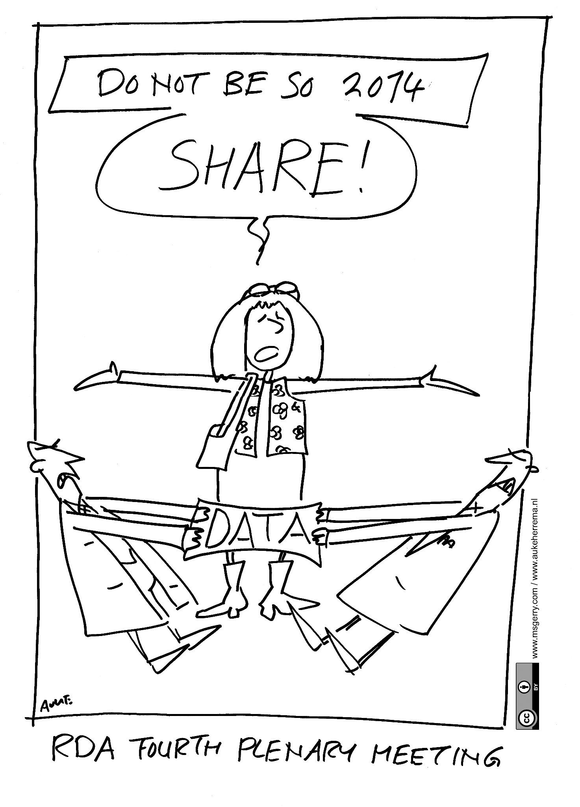
Data availability policy: as open as possible, as closed as necessary
From http://aukeherrema.nl in CC-BY
Notes:
Public funders require also open data, as much as possible

Slide 27
All that is FAIR is OPEN and vice-versa
What do you think?

Slide 28
Open vs. FAIR data: Open data is different from FAIR data
DATA
Open
FAIR
Restricted
Closed
Notes:
Now that we have clarified what FAIR means, it is important to remember that FAIR is different from Open.

Slide 29
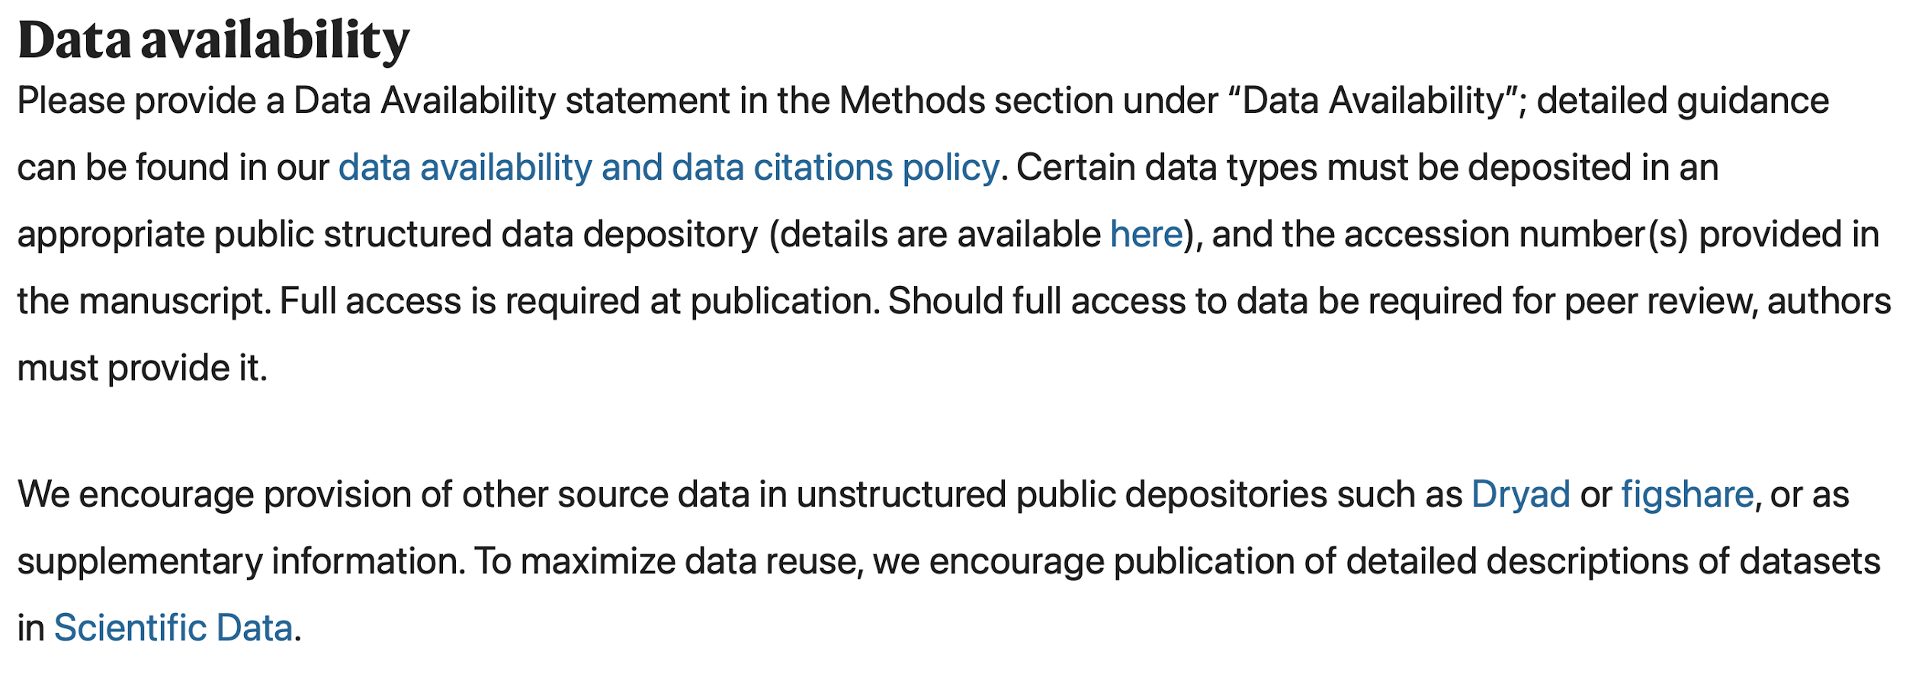
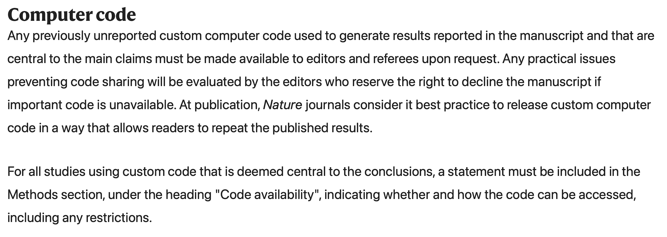
Journals: no available data, no paper
https://www.nature.com/nature/for-authors/initial-submission
Notes:
Sources:
https://www.nature.com/nature-portfolio/editorial-policies/reporting-standards
https://researchdata.springernature.com/posts/tips-for-writing-a-dazzling-das-data-availability-statement?utm_source=sn&utm_medium=referral&utm_content=organic&utm_campaign=RSDT_1_IR01_GL_sn_policies-das

Slide 30
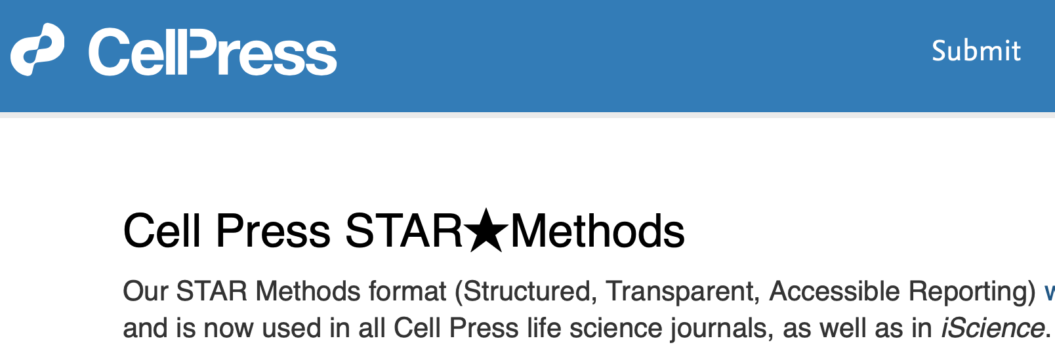
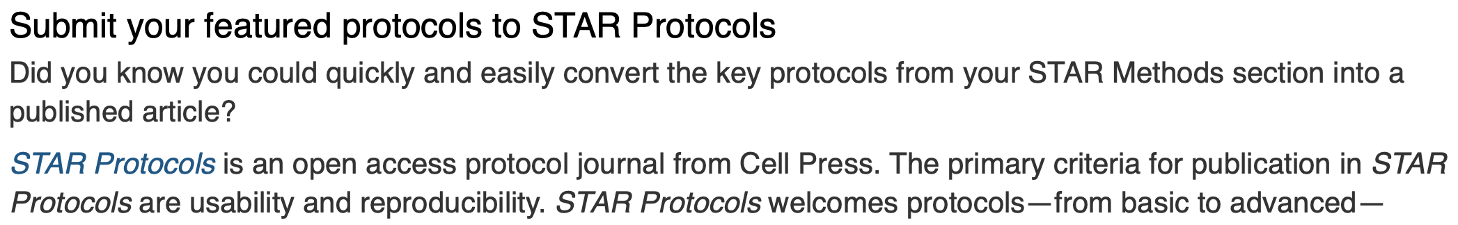
Journals: no available data, no paper
https://www.cell.com/star-authors-guide

Slide 31
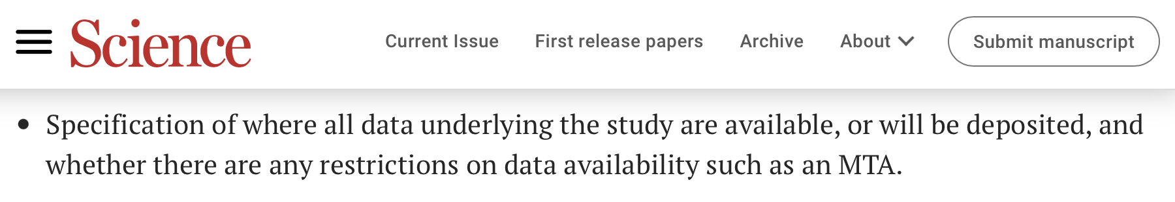
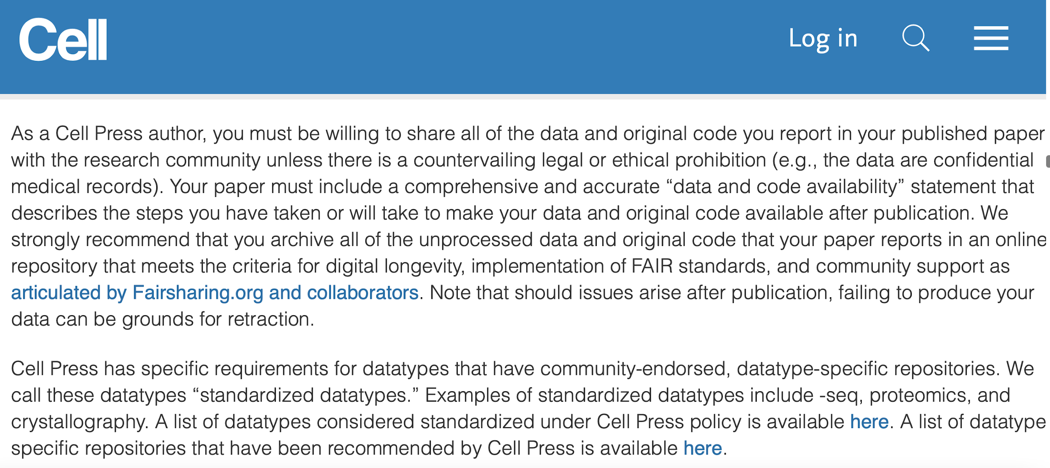
Journals request FAIR data
https://www.science.org/content/page/science-information-authors
FAIR?
https://www.cell.com/cell/authors

Slide 32
What are the benefits of good RDM?
Let’s write possible reasons
use pens and papers

Slide 33
Benefits of good RDM (or FAIR data)
During the project
Reduce the risk of data loss
Less time (and money) spent
looking for unfindable data
redoing not documented experiments/analysis
Increase efficiency and smooth collaboration in a team (easier and faster way for sharing information)
More control over data access (who, when, how, etc.)
More clear documentation for people onboarding the team and by people leave the team
Easier data reuse (samples, raw data, scripts, analysis etc.)
Notes:
Why do we care about data?

Slide 34
Benefits of good RDM (or FAIR data)
During the project
Reduce the risk of data loss
Less time (and money) spent
looking for unfindable data
redoing not documented experiments/analysis
Increase efficiency and smooth collaboration in a team (easier and faster way for sharing information)
More control over data access (who, when, how, etc.)
More clear documentation for people onboarding the team and by people leave the team
Easier data reuse (samples, raw data, scripts, analysis etc.)
Notes:
Why do we care about data?

Slide 35
Benefits of good RDM (or FAIR data)
During the project
Reduce the risk of data loss
Less time (and money) spent
looking for unfindable data
redoing not documented experiments/analysis
Increase efficiency and smooth collaboration in a team (easier and faster way for sharing information)
More control over data access (who, when, how, etc.)
More clear documentation for people onboarding the team and by people leave the team
Easier data reuse (samples, raw data, scripts, analysis etc.)
Notes:
Why do we care about data?

Slide 36
Benefits of good RDM (or FAIR data)
During the project
Reduce the risk of data loss
Less time (and money) spent
looking for unfindable data
redoing not documented experiments/analysis
Increase efficiency and smooth collaboration in a team (easier and faster way for sharing information)
More control over data access (who, when, how, etc.)
More clear documentation for people onboarding the team and by people leave the team
Easier data reuse (samples, raw data, scripts, analysis etc.)
Notes:
Why do we care about data?

Slide 37
Benefits of good RDM (or FAIR data)
During the project
Reduce the risk of data loss
Less time (and money) spent
looking for unfindable data
redoing not documented experiments/analysis
Increase efficiency and smooth collaboration in a team (easier and faster way for sharing information)
More control over data access (who, when, how, etc.)
More clear documentation for people onboarding the team and by people leave the team
Easier data reuse (samples, raw data, scripts, analysis etc.)
Notes:
Why do we care about data?

Slide 38
Benefits of good RDM (or FAIR data)
During the project
Reduce the risk of data loss
Less time (and money) spent
looking for unfindable data
redoing not documented experiments/analysis
Increase efficiency and smooth collaboration in a team (easier and faster way for sharing information)
More control over data access (who, when, how, etc.)
More clear documentation for people onboarding the team and by people leave the team
Easier data reuse (samples, raw data, scripts, analysis etc.)
Notes:
Why do we care about data?

Slide 39
Benefits of good RDM (or FAIR data)
After the project
Results are reproducible by others
Transparent and trustworthy data and science (and paper) among your peers
Higher impact in scientific community and possibly more citations
Integration of several data sources from different disciplines could lead to new discoveries
New discoveries at a lower cost by reusing high quality existing data
Less duplication of work
Notes:
Why do we care about data?

Slide 40
Benefits of good RDM (or FAIR data)
After the project
Results are reproducible by others
Transparent and trustworthy data and science (and paper) among your peers
Higher impact in scientific community and possibly more citations
Integration of several data sources from different disciplines could lead to new discoveries
New discoveries at a lower cost by reusing high quality existing data
Less duplication of work
Notes:
Why do we care about data?

Slide 41
Benefits of good RDM (or FAIR data)
After the project
Results are reproducible by others
Transparent and trustworthy data and science (and paper) among your peers
Higher impact in scientific community and possibly more citations
Integration of several data sources from different disciplines could lead to new discoveries
New discoveries at a lower cost by reusing high quality existing data
Less duplication of work
Notes:
Why do we care about data?

Slide 42
Benefits of good RDM (or FAIR data)
After the project
Results are reproducible by others
Transparent and trustworthy data and science (and paper) among your peers
Higher impact in scientific community and possibly more citations
Integration of several data sources from different disciplines could lead to new discoveries
New discoveries at a lower cost by reusing high quality existing data
Less duplication of work
Notes:
Why do we care about data?

Slide 43
Benefits of good RDM (or FAIR data)
After the project
Results are reproducible by others
Transparent and trustworthy data and science (and paper) among your peers
Higher impact in scientific community and possibly more citations
Integration of several data sources from different disciplines could lead to new discoveries
New discoveries at a lower cost by reusing high quality existing data
Less duplication of work
Notes:
Why do we care about data?

Slide 44
Benefits of good RDM (or FAIR data)
After the project
Results are reproducible by others
Transparent and trustworthy data and science (and paper) among your peers
Higher impact in scientific community and possibly more citations
Integration of several data sources from different disciplines could lead to new discoveries
New discoveries at a lower cost by reusing high quality existing data
Less duplication of work
Notes:
Why do we care about data?

Slide 45
How to approach RDM starting with “the end” (FAIR metadata) in mind
Choose the right repositories for your data
Learn the requirements of the selected repositories
Start writing and applying your DMP document
Notes:
Why do we care about data?

Slide 46
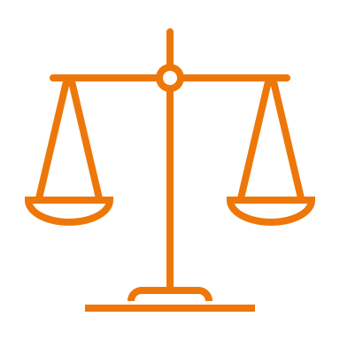

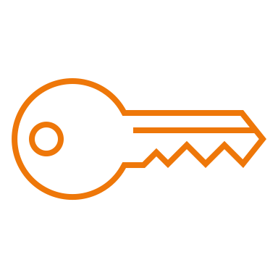

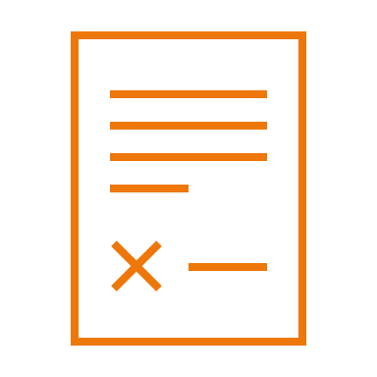
How to choose the right repositories for your data
1. Ethical and legal issues
3. Consultation with experts
4. Access restrictions and/or reuse limitations
5. Appropriate repositories
2. Data availability requirements

Slide 47

Learn the requirements of the selected repositories
4. Documentation & metadata requirements
1. Data policies
2. File formats
3. Costs

Slide 48

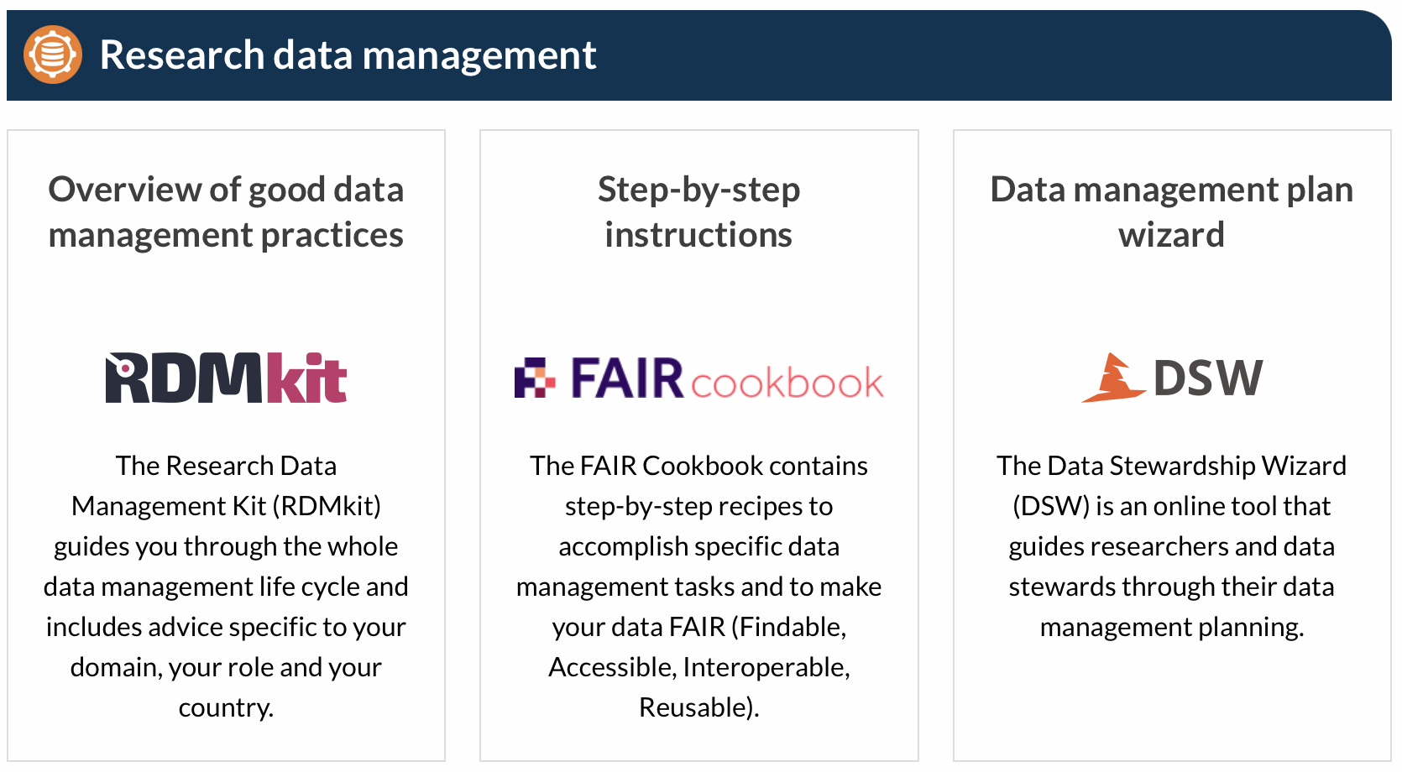

Useful resources for RDM best practices and guidelines
RDMkit: the research data management toolkit for life sciences by ELIXIR (https://elixir-europe.org)
ELIXIR research data management guidelines and best practices (https://elixir-europe.org/what-we-offer/guidelines )
ELIXIR Belgium services for RDM (https://www.elixir-belgium.org/research_data_management)
RDM Guide by ELIXIR Belgium
https://rdmkit.elixir-europe.org
https://rdm.elixir-belgium.org

Slide 49
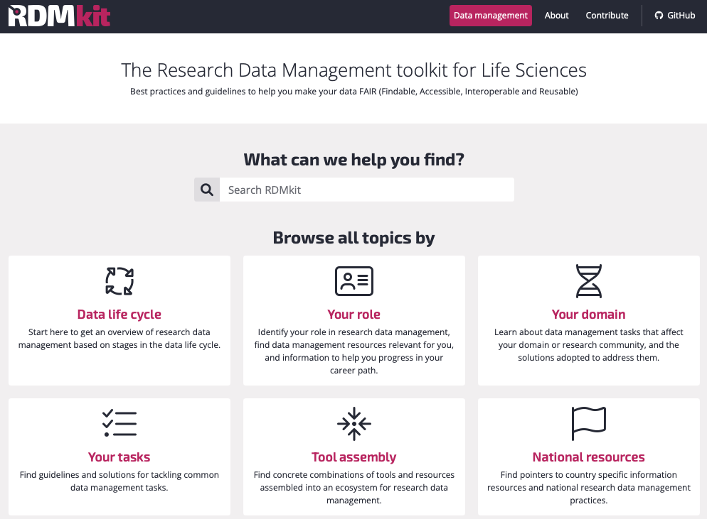
RDMkit: research data management best practices and guidelines for life sciences
https://rdmkit.elixir-europe.org

Slide 50
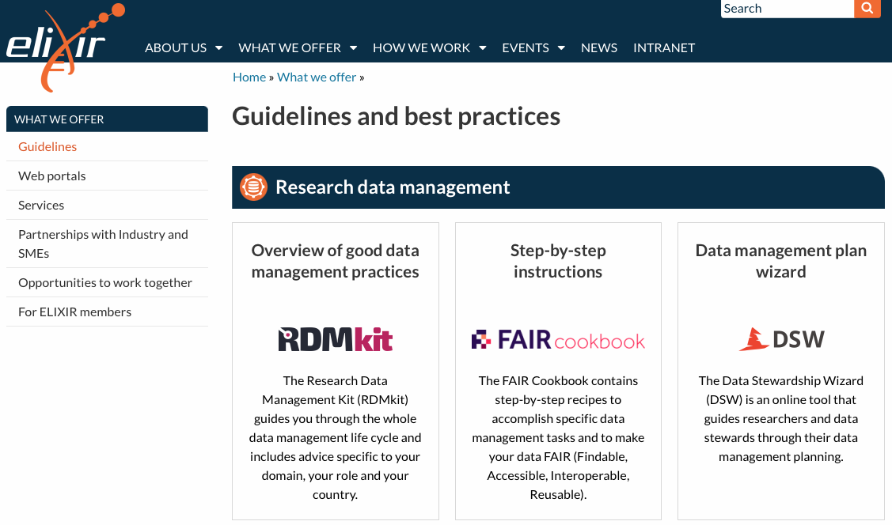
ELIXIR research data management guidelines and best practices
https://elixir-europe.org/what-we-offer/guidelines

Slide 51
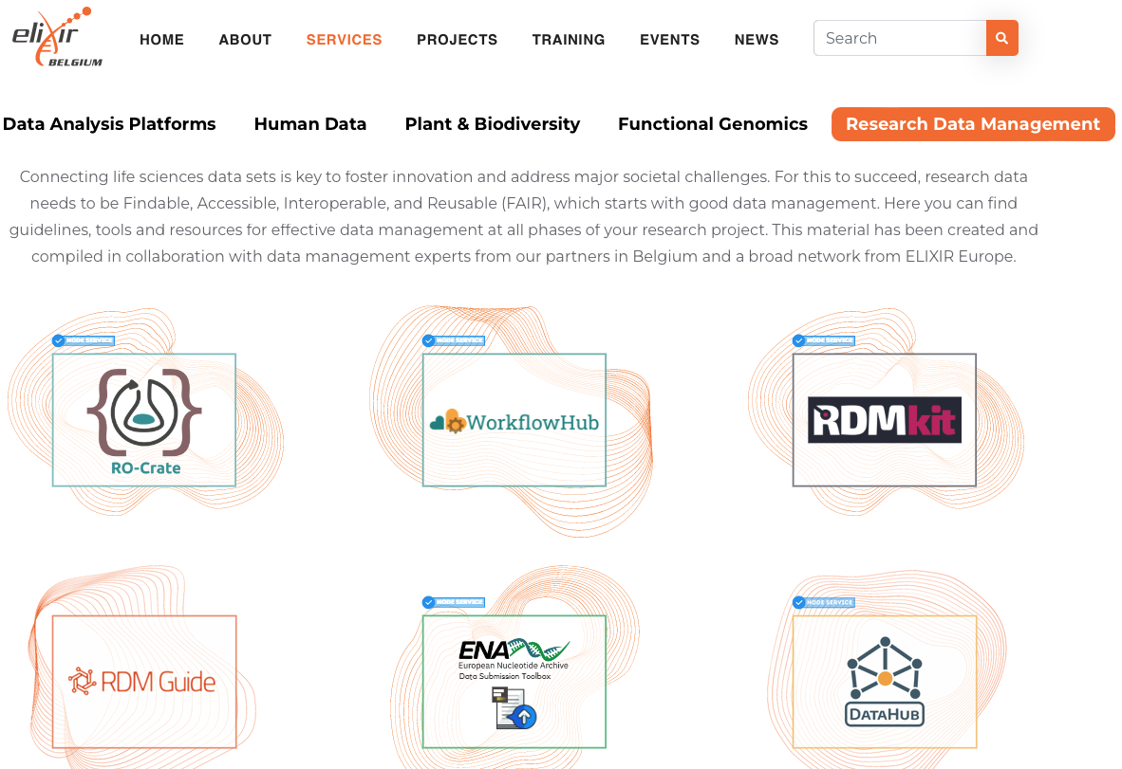
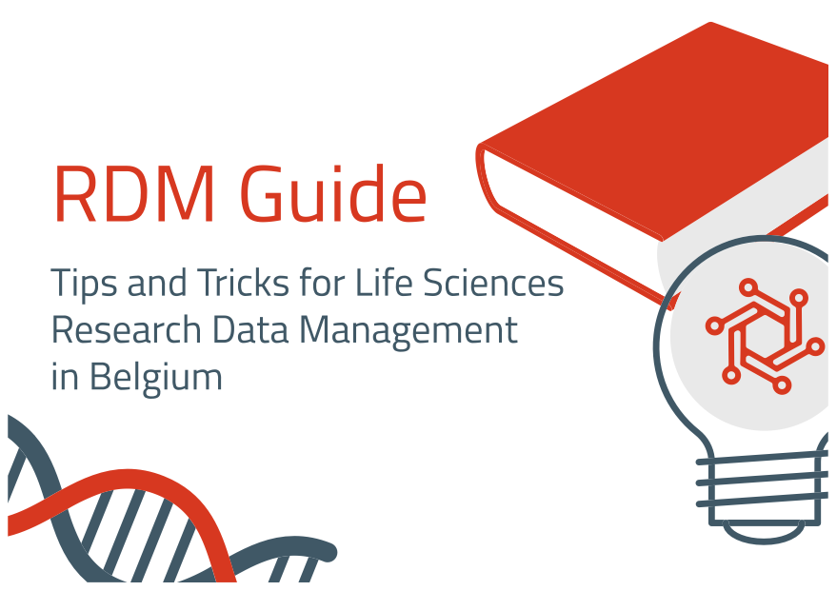
ELIXIR Belgium services for RDM – RDM Guide
https://www.elixir-belgium.org/services#term-25
https://rdm.elixir-belgium.org

Slide 52
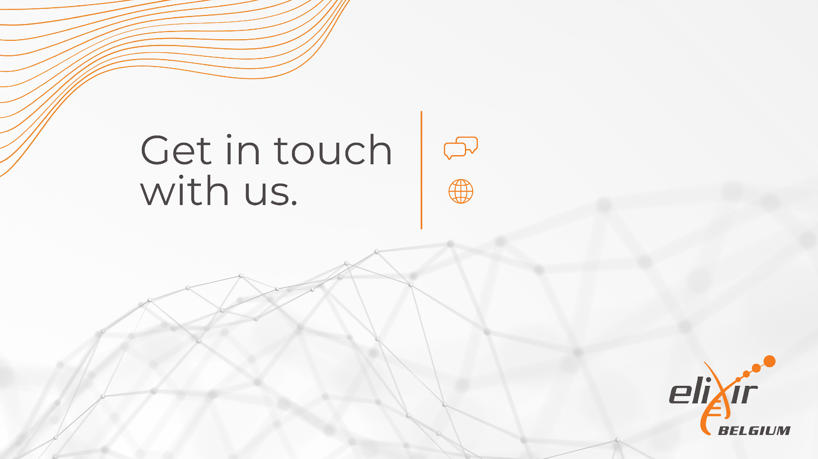
info@elixir-belgium.org
https://www.elixir-belgium.org
This work is licensed under the Creative Commons Attribution 4.0 International License. To view a copy of this license, visit http://creativecommons.org/licenses/by/4.0/.

Slide 53
Conclusions
RDM includes all tasks needed to make (meta)data well described, easy to find, secure and reusable
Funders and scientific journals require DMP, open and FAIR data
Open data is different from FAIR data
Benefits of good RDM for the research and the researchers
During the project
After the project
Starting your DMP and your research project with FAIR (meta)data in mind eases data publication
Use available resources for RDM in life sciences provided by ELIXIR (Belgium)

Slide 54
Outline
What is Research Data Management (RDM) (Gestão de dados de Pesquisa)
Why do we do RDM (Gestão de dados de Pesquisa)
Open data VS FAIR data
What are the benefits of good RDM (Gestão de dados de Pesquisa)
During the project
After the project
How to approach RDM starting with "the end" (FAIR metadata) in mind
ELIXIR (Belgium) resources for RDM

Slide 55
Funders requiremets:
Data management plan (DMP)
Data availability policy:
“as open as possible, as closed as necessary”

Slide 56
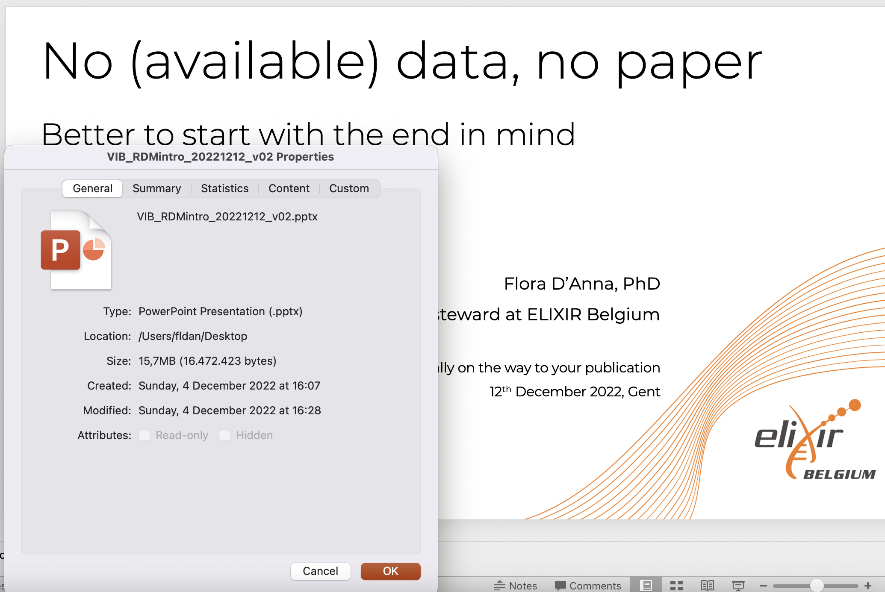
Metadata is highly structured documentation
Example 1: machine-actionable metadata of a PowerPoint file
Data
Metadata
fields
Metadata
Notes:
In this example, metadata are machine-actionable because you can use it to order the files by “last modified” or “creation date” etc.
Another example: Metadata of this course is the title, the dates, number of participants, names of organisers and trainers etc; the data is the content of the course

Slide 57
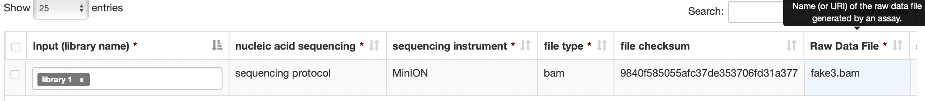

Example 2: metadata of a DNA sequencing experiment
Metadata fields or attributes
Metadata
Data
From https://datahub.test.elixir-belgium.org
WARNING:
Data VS Metadata
The difference is often dependent on the research question
What is considered metadata by someone can be used as data by others in a different context
Notes:
Source:
https://datahub.test.elixir-belgium.org
https://datahub.elixir-belgium.org

Slide 58
Example 3: metadata for a study about the most used file type in sequencing
Metadata fields or attributes
Metadata
Data
From https://datahub.test.elixir-belgium.org
WARNING:
Data VS Metadata
The difference is often dependent on the research question
What is considered metadata by someone can be used as data by others in a different context
Notes:
Source:
https://datahub.test.elixir-belgium.org
https://datahub.elixir-belgium.org

Slide 59
Write and implement your DMP
What’s “data” in DMP ? How are you going to manage it during and after the project?
Digital or digitalised information
Physical materials
Software, other reseach output

